Slide 1


Introduction to Python – Week 9
Mark Smith

Slide 2
Course outline
Lesson 1 – Getting Started: Introduction and Arithmetic Operators
Lesson 2 – Types and Variables
Lesson 3 – Functions
Lesson 4 – Conditional Statements
Lesson 5 – Further Conditionals and Recursion
Lesson 6 – Functions with Return Values
Lesson 7 – Loops, Lists and Turtles
Lesson 8 – Snake Project
Lesson 9 – Review of previous materials

Slide 3
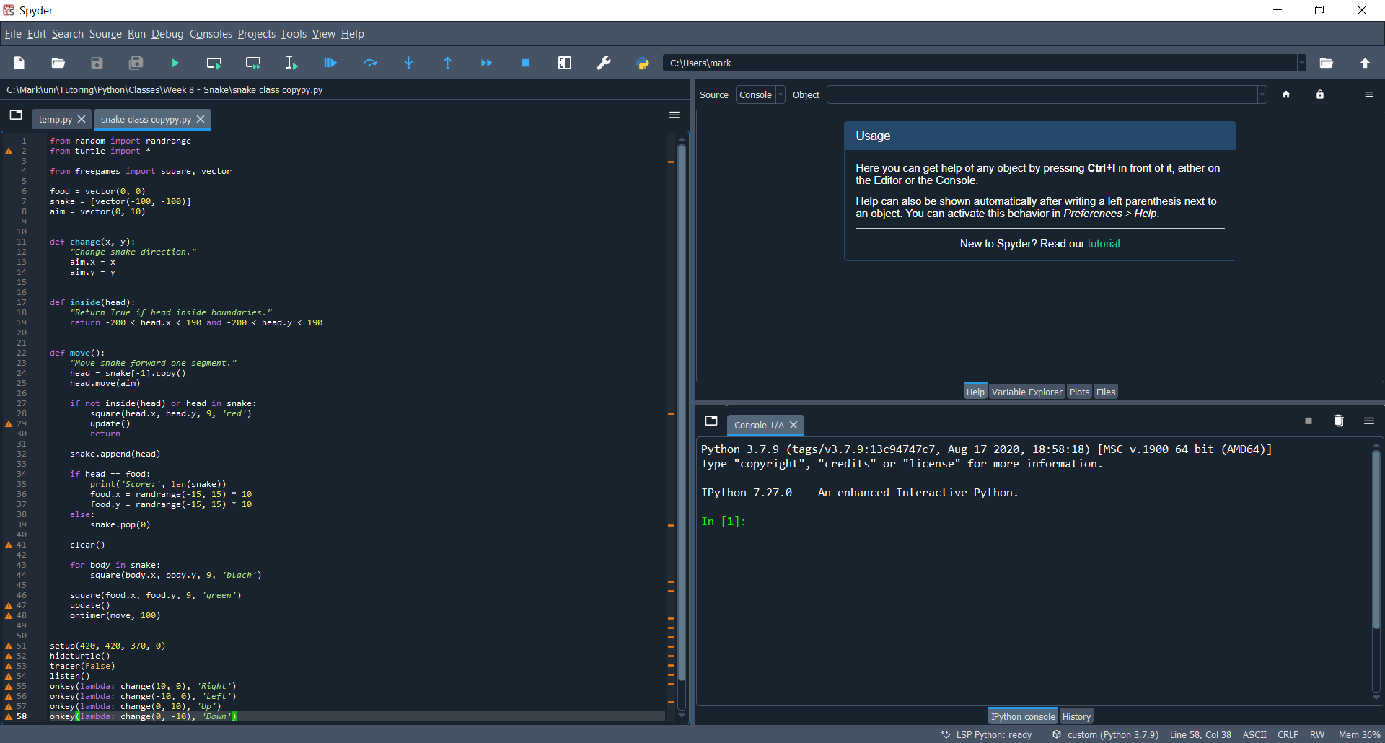
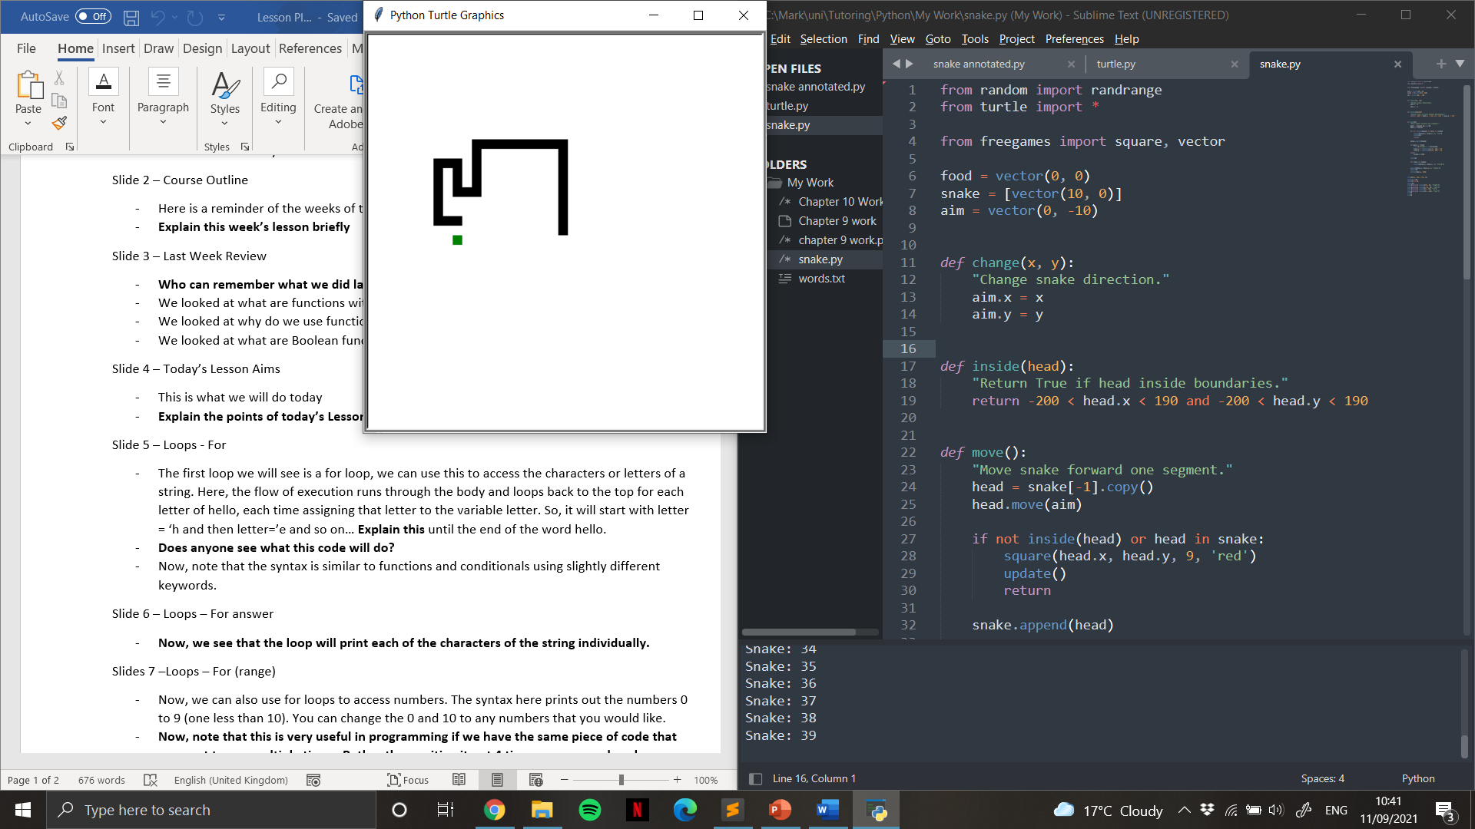
Last Week
How do we code snake?

Slide 4
This Week – Review of previous material
Today we will review:
How do we use functions?
How do we use conditionals?
How do we use loops?

Slide 5
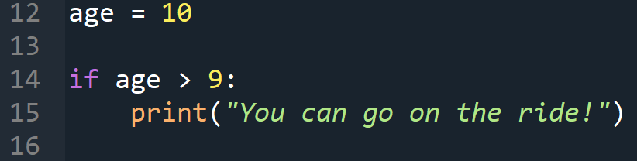
conditionals
How do we write conditional statements?

Slide 6
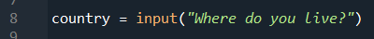
Conditionals - input
How do we ask the user for input?
Let’s do some exercises on conditional statements!

Slide 7
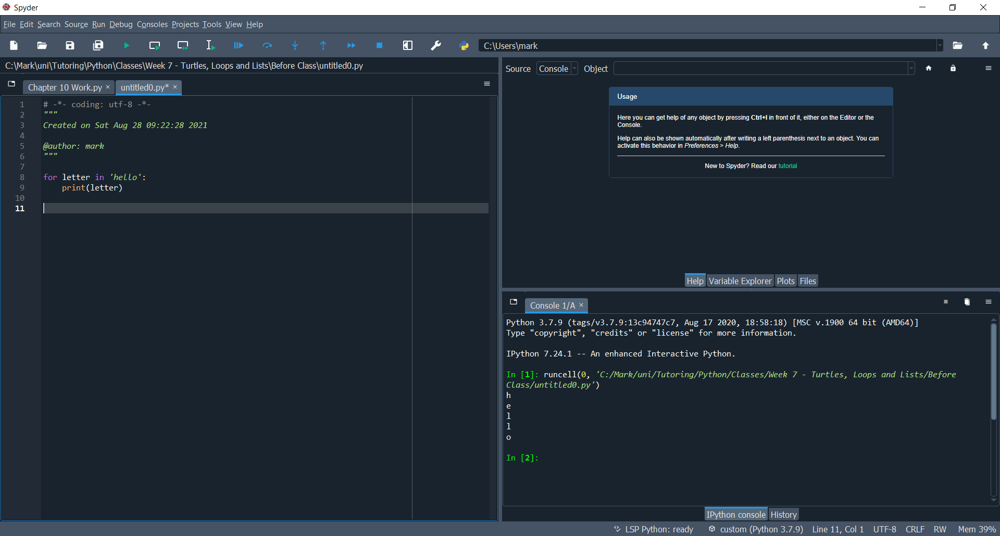
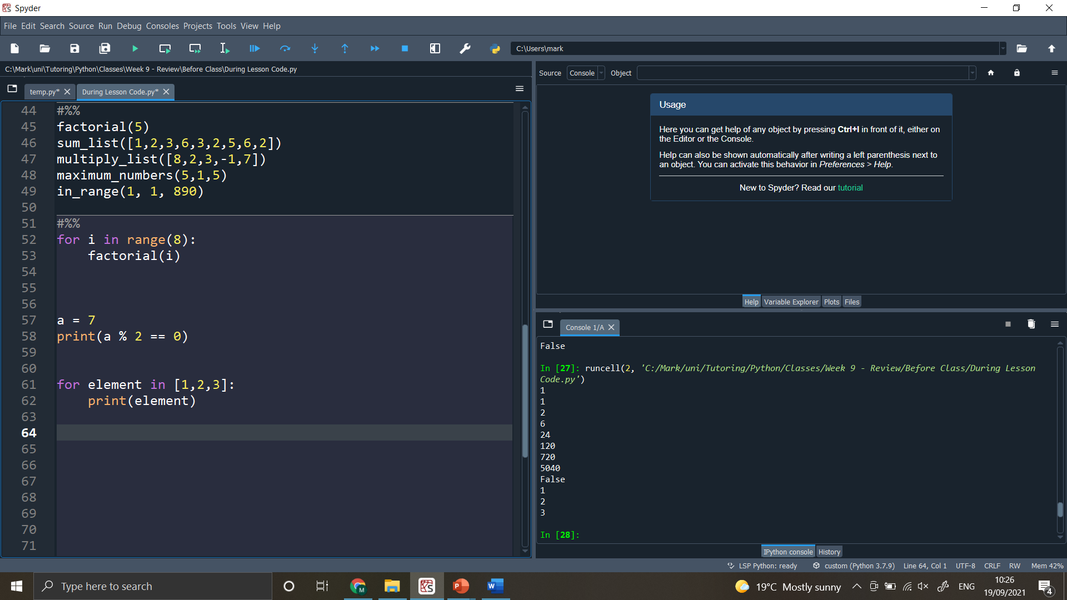
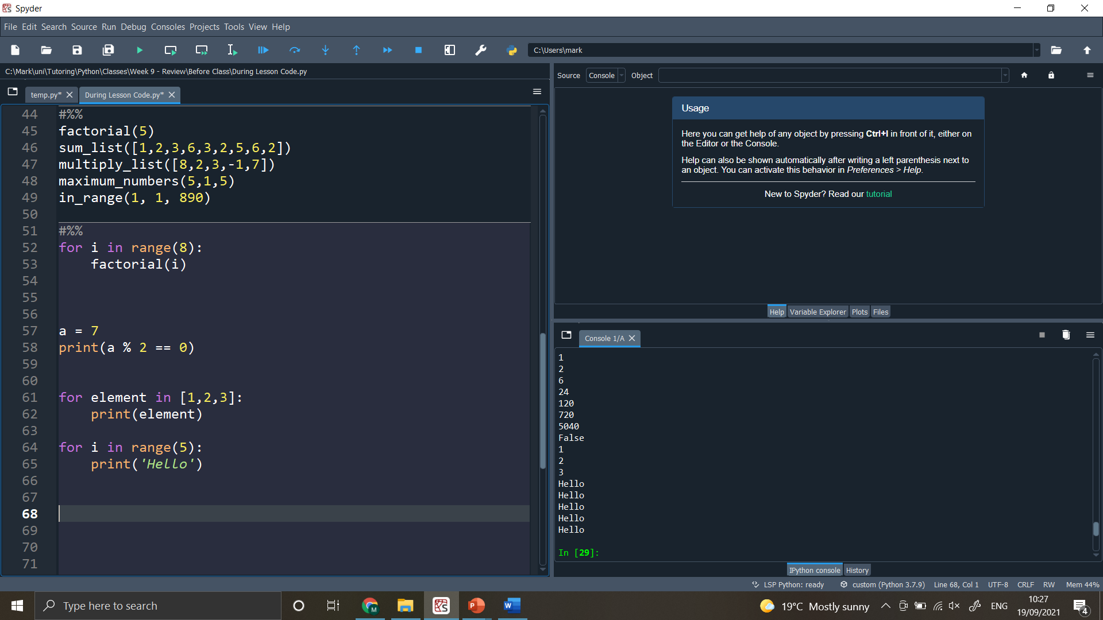
Loops
The first loop we will see is a for loop, we can use this in a few different ways:
To access the letters of a string, one at a time
To access elements of a list, one at a time
To run some code a given number of times

Slide 8
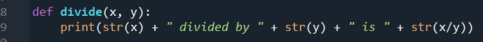
functions
How do we write functions?
Let’s do some exercises on functions!

Slide 9
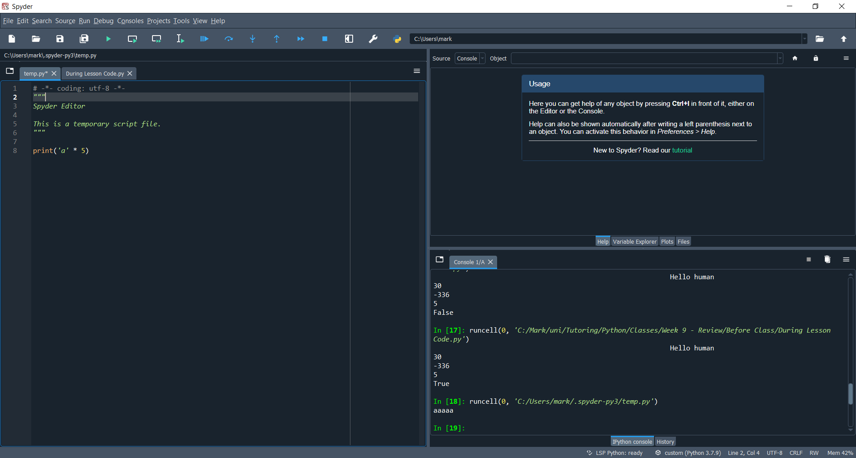
Functions – Useful code
Here is some useful code for the exercises!
prints
What is 3! ?
What is 8! ?
What is 10! ?
5! Means 5 ‘factorial’
5! = 5 x 4 x 3 x 2 x 1

Slide 10
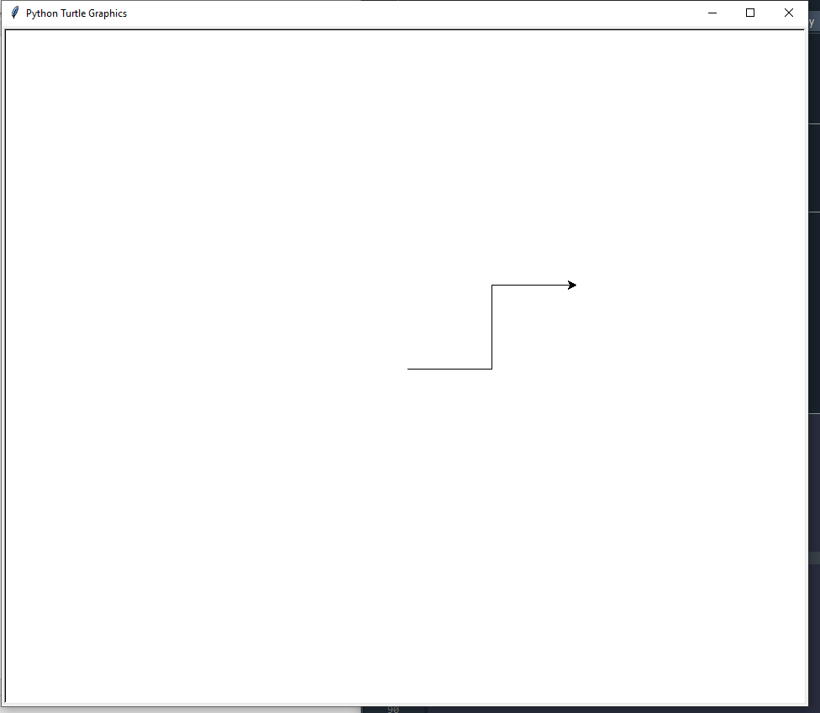
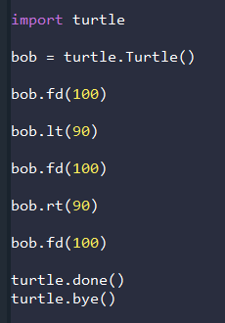
turtle
Remember turtle?
Here’s the code, can you remember how it works?

Slide 11
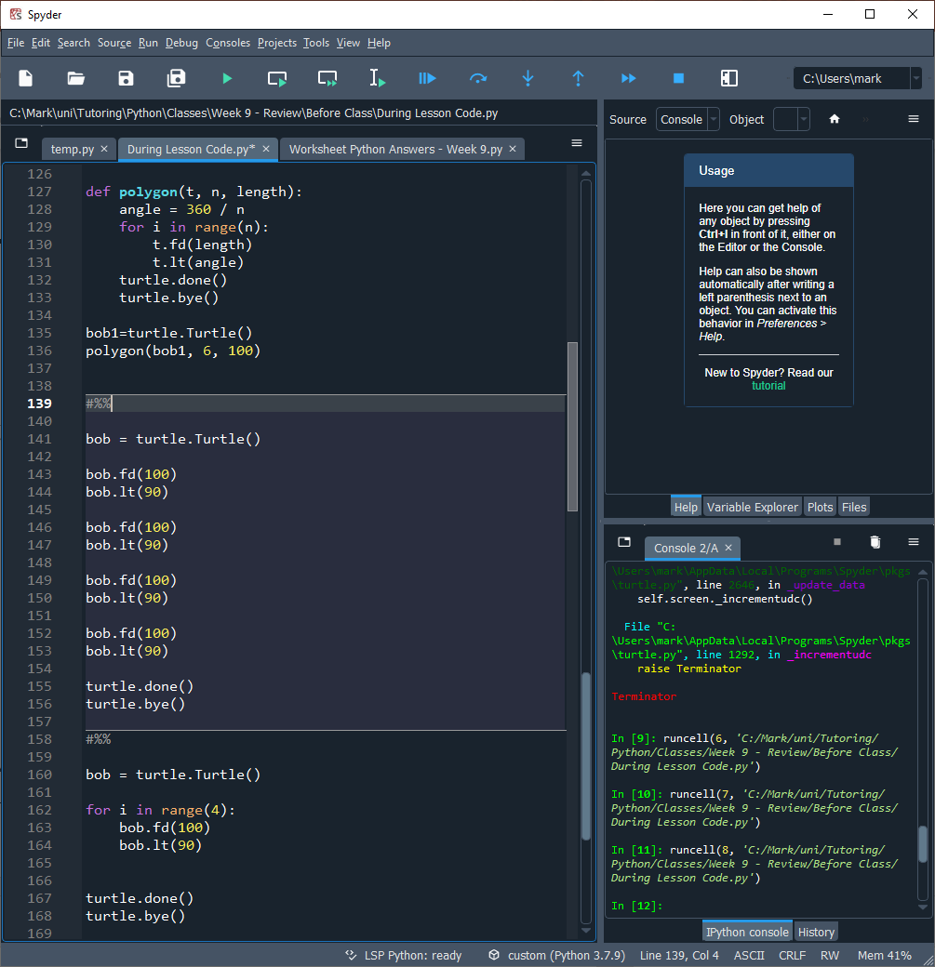
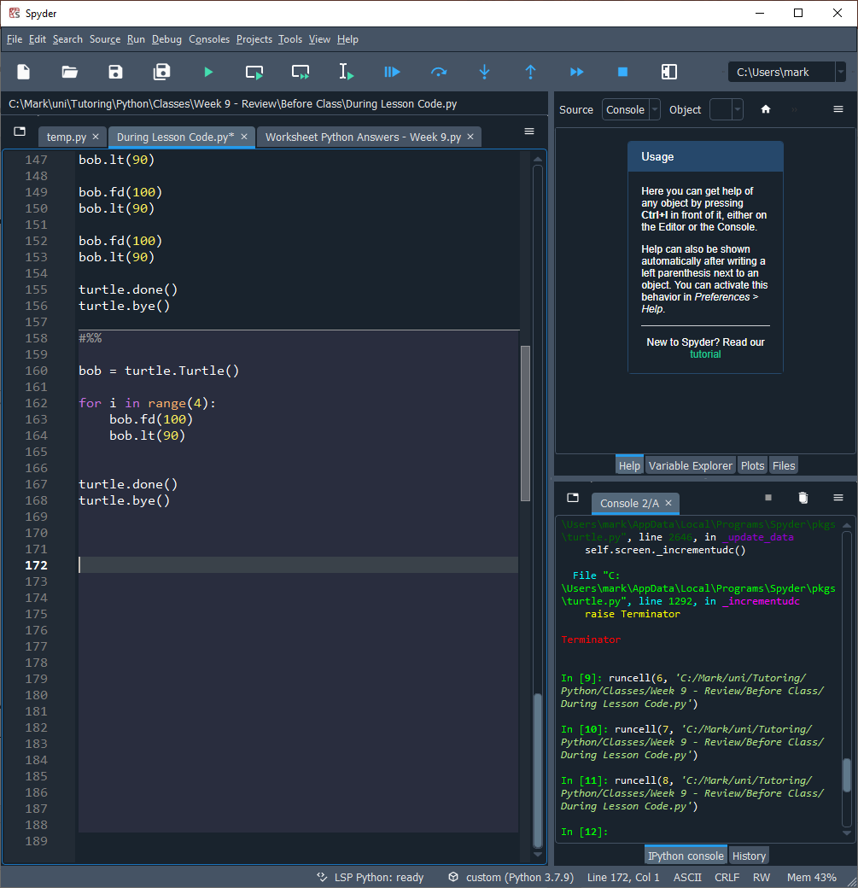
turtle
How do we draw a square?
How do we make the code shorter?
Remember turtle?

Slide 12
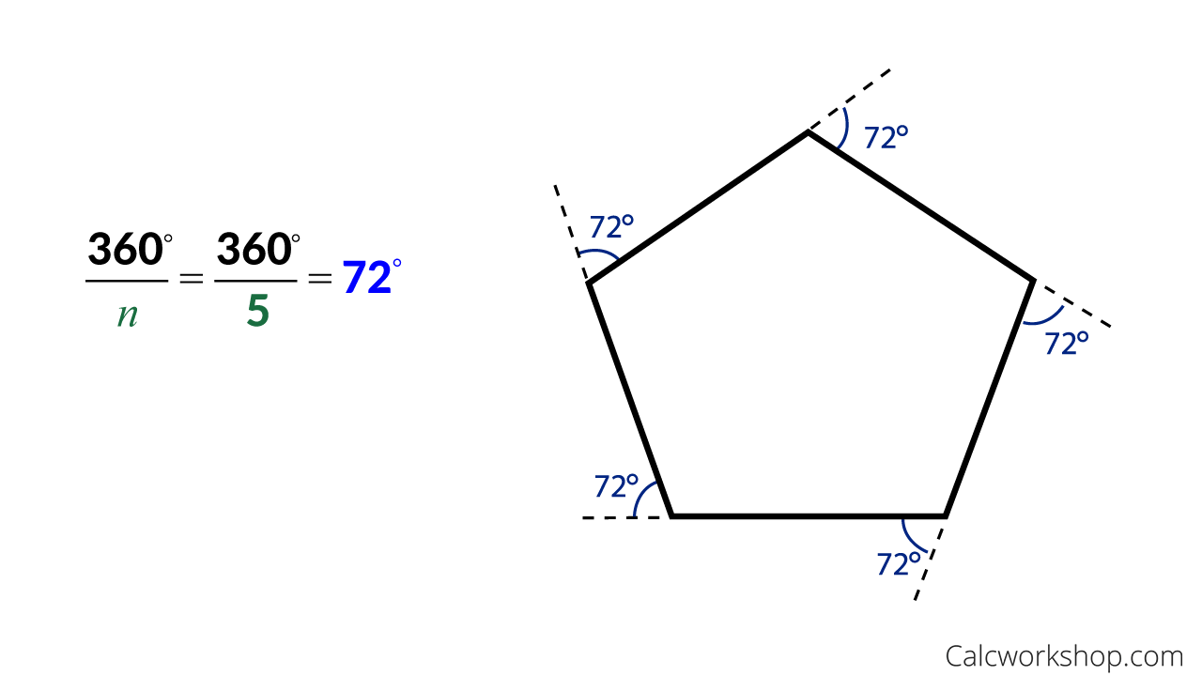
turtle
Here are some exercises:
Draw a triangle
Write a function to draw the triangle
Write a function to draw a square
Draw a 5 and 6 sided shape
Write a function that draws an n-sided shape
Remember turtle?
Hint: Exterior angles of an n-sided shape are 360/n

Slide 13
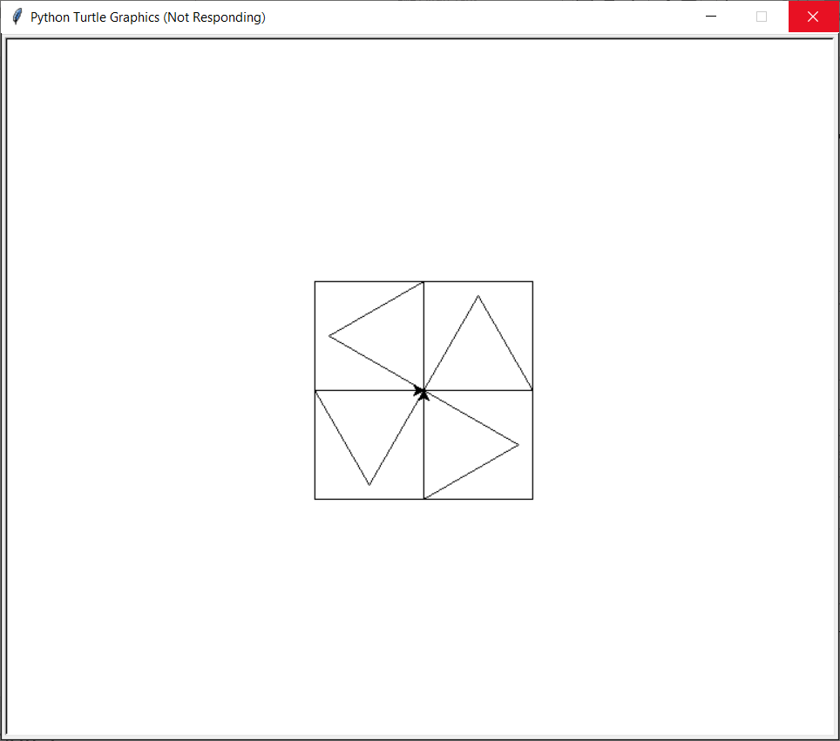
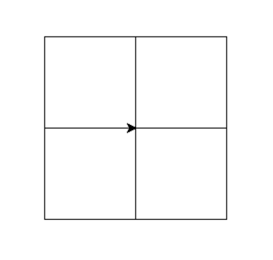
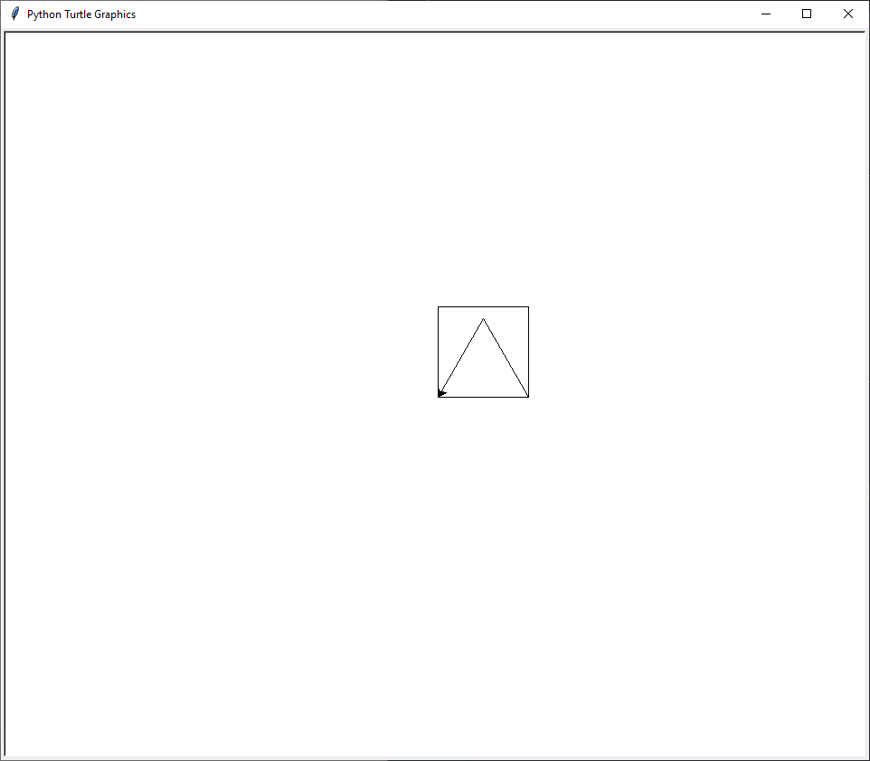
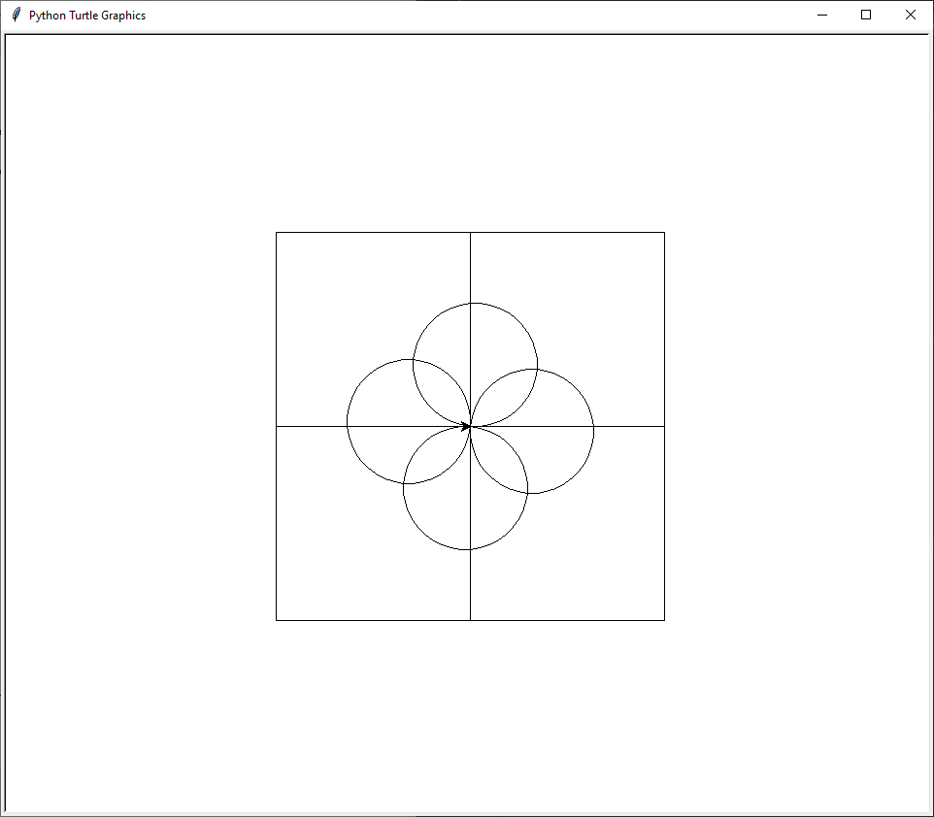
turtle
Now use your functions together to draw some shapes!

Slide 14
End of class
This week we have looked at:
What are Relational Operators
What are Conditional Operators
How do we use Conditional statements

